Slide 1
CE 395R 5- Data Mining
Neural Networks

Slide 2
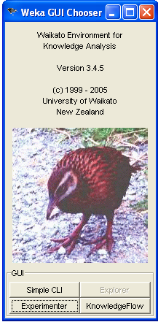
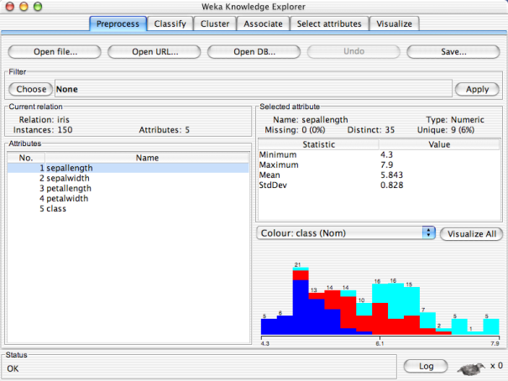

Slide 3
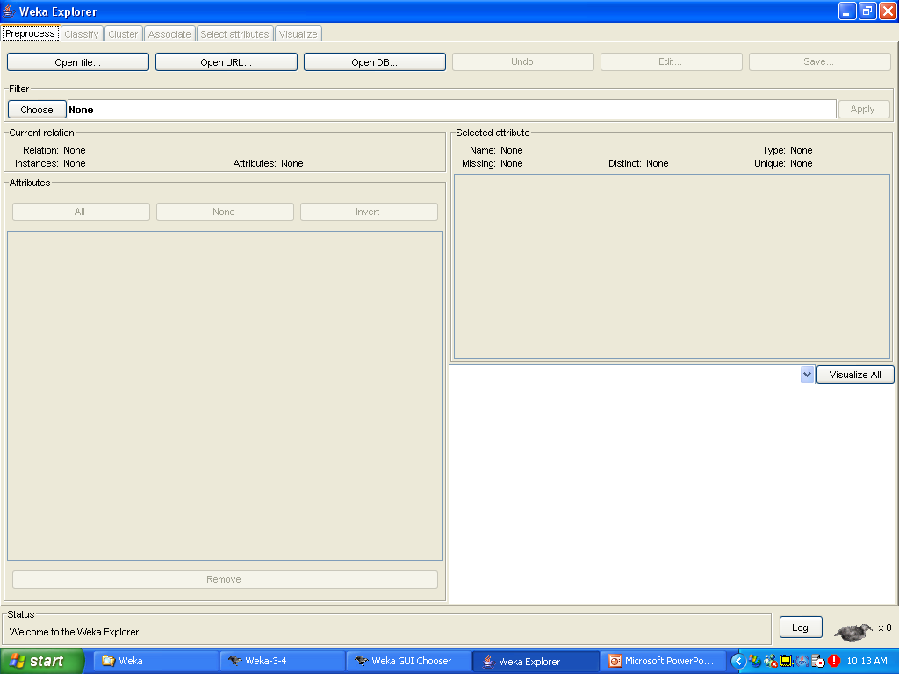

Slide 5
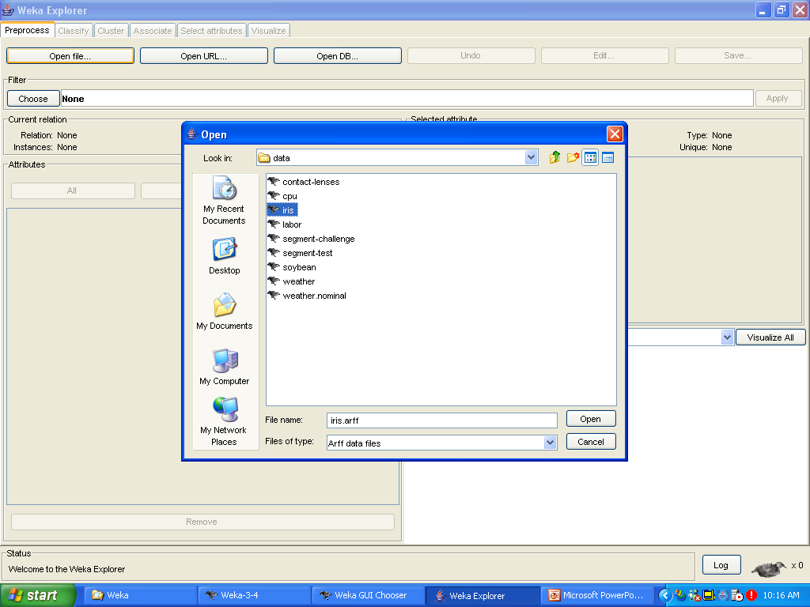

Slide 6
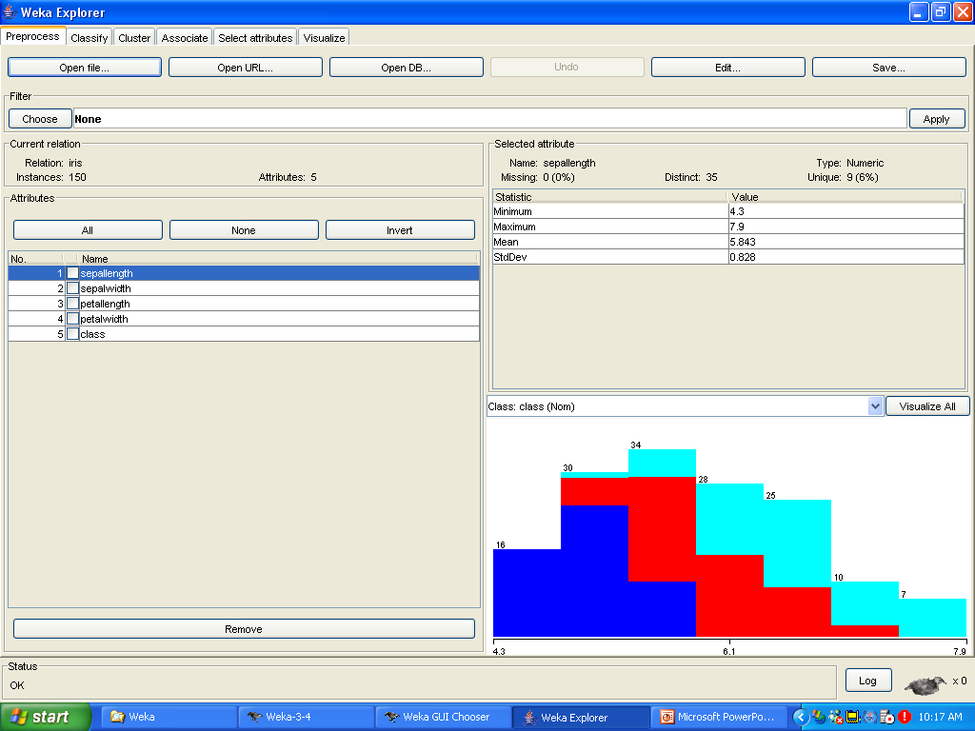

Slide 8
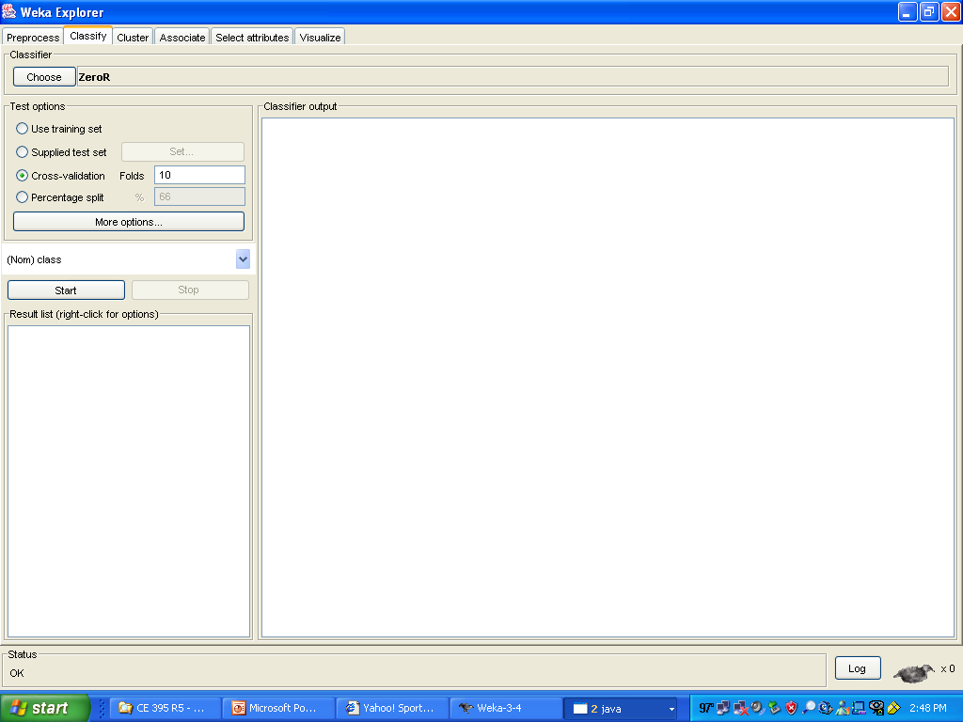

Slide 10
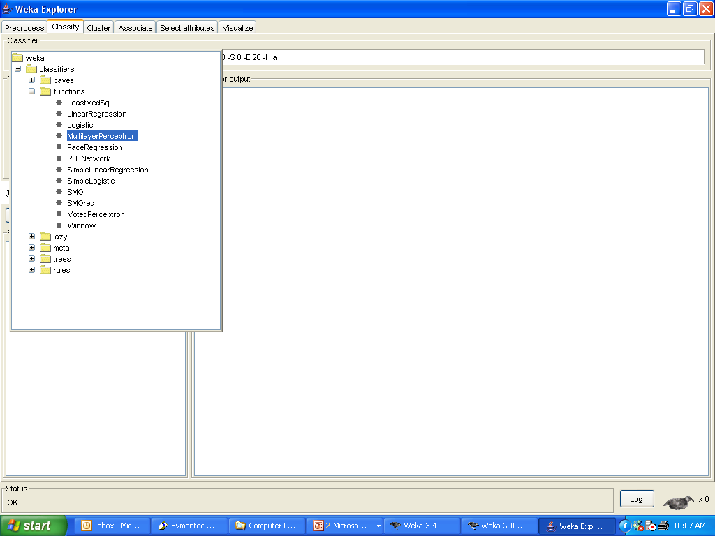

Slide 11
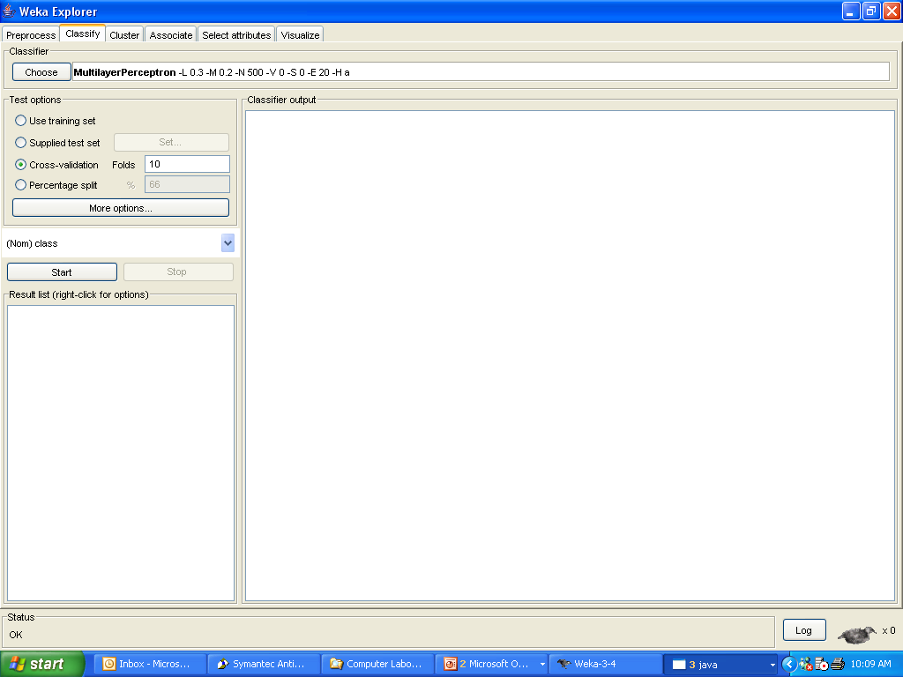
right-click

Slide 12
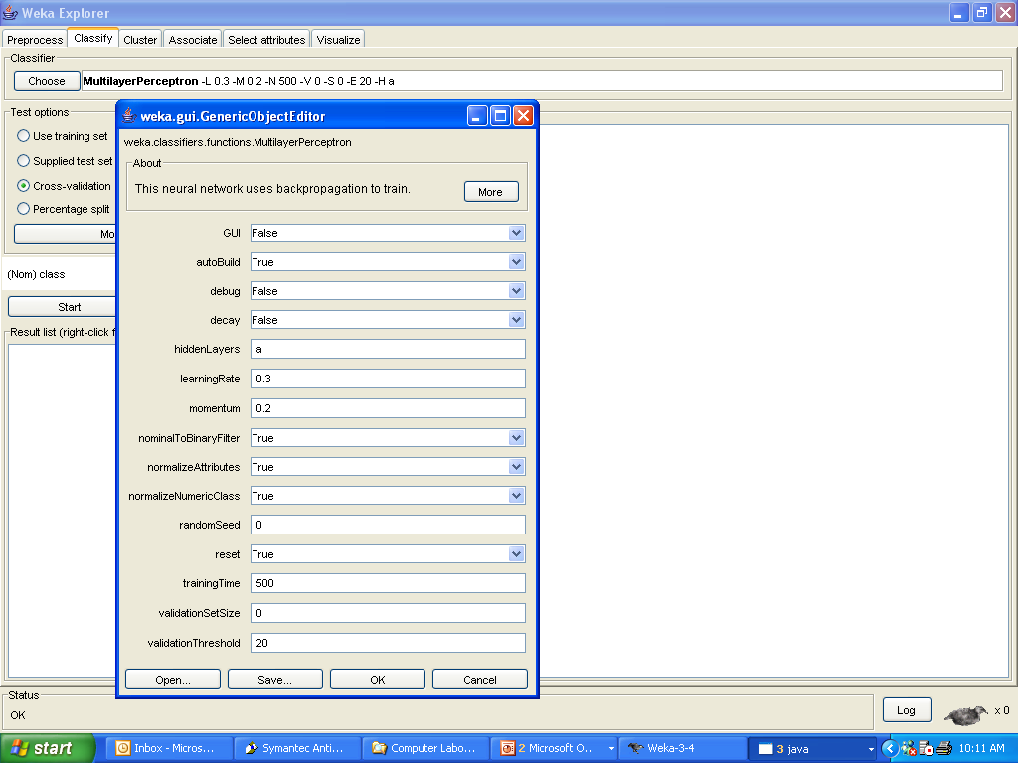

Slide 13
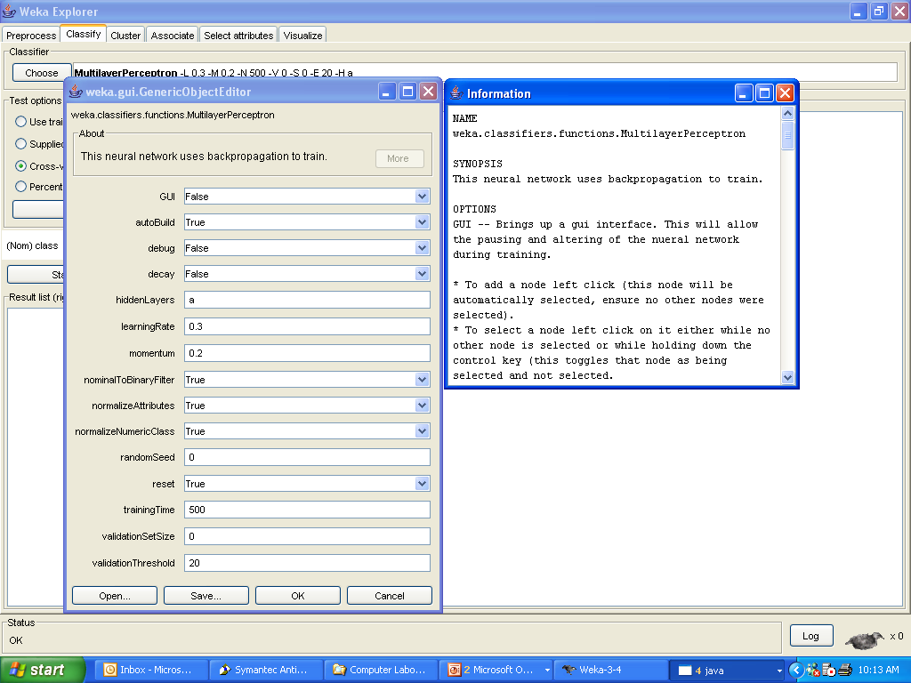

Slide 14
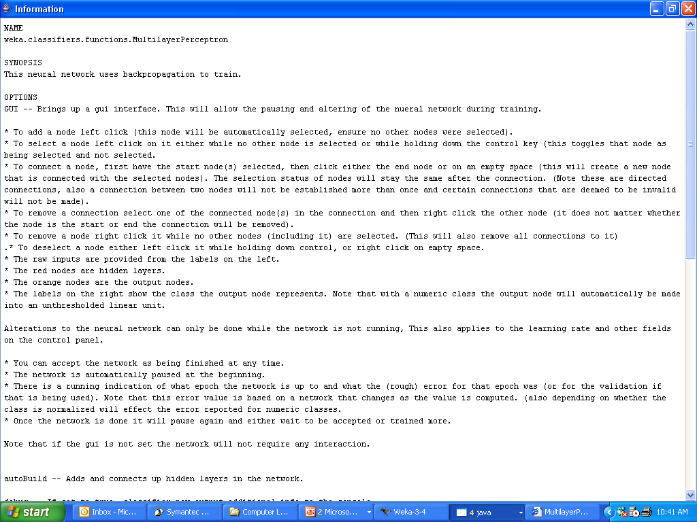

Slide 15
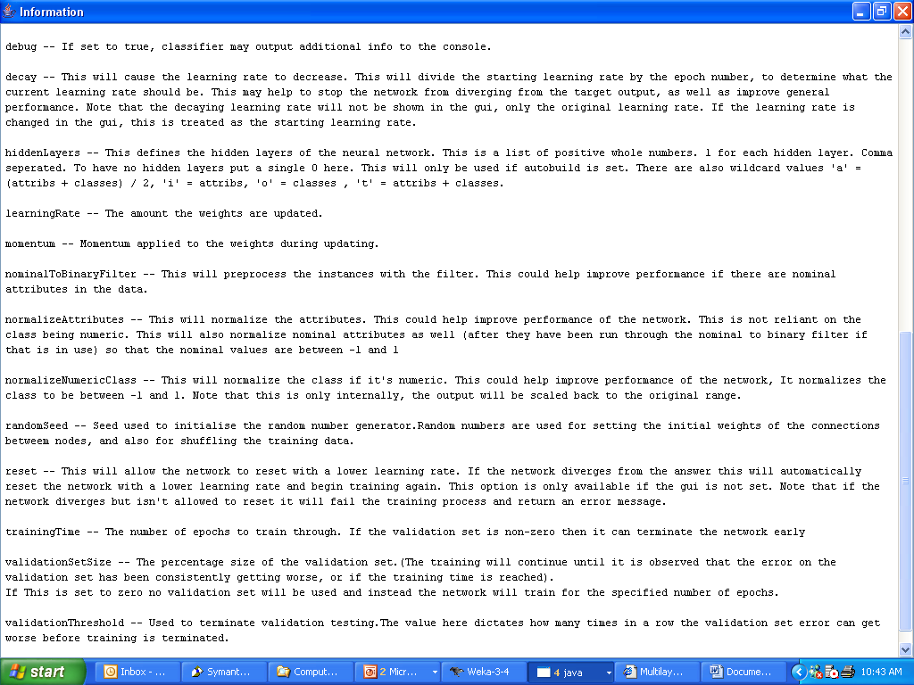

Slide 17
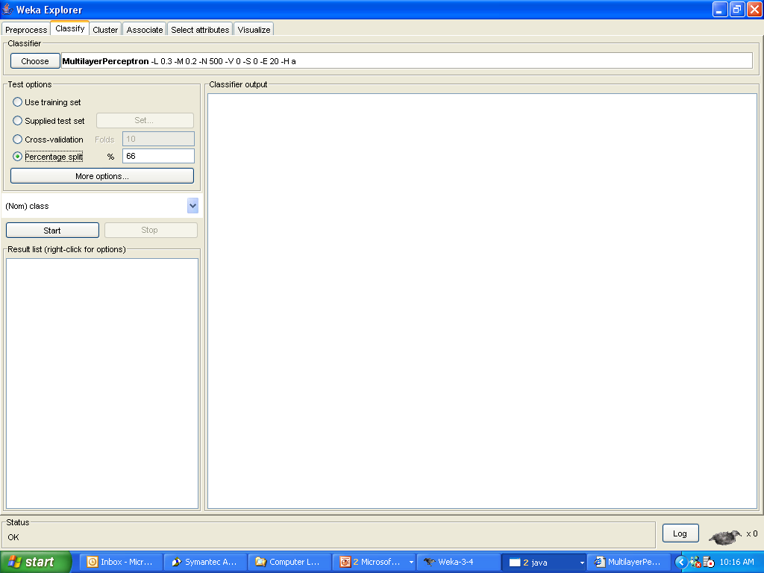

Slide 18
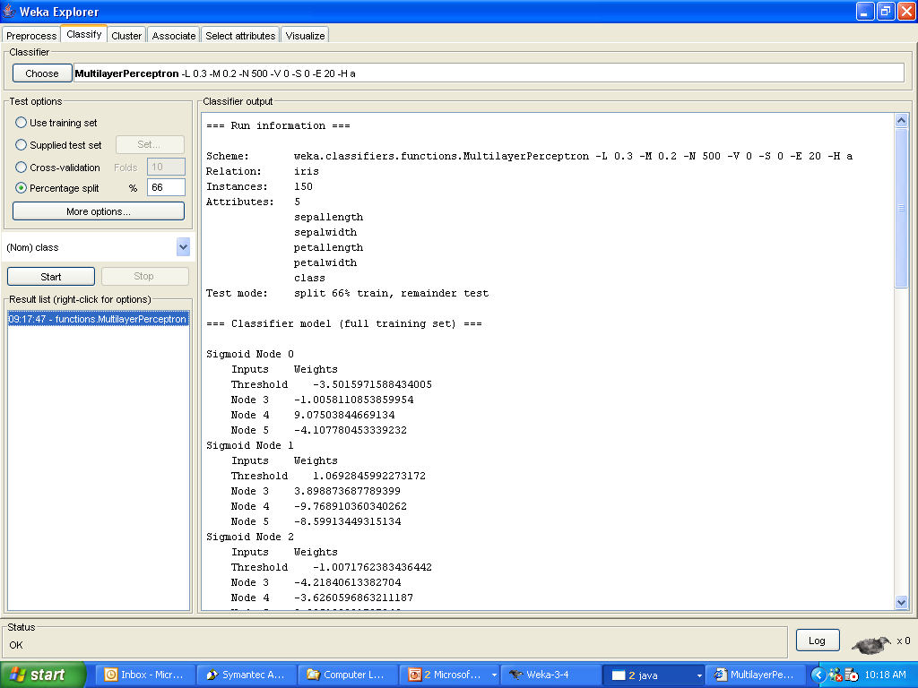

Slide 19
right-click

Slide 20
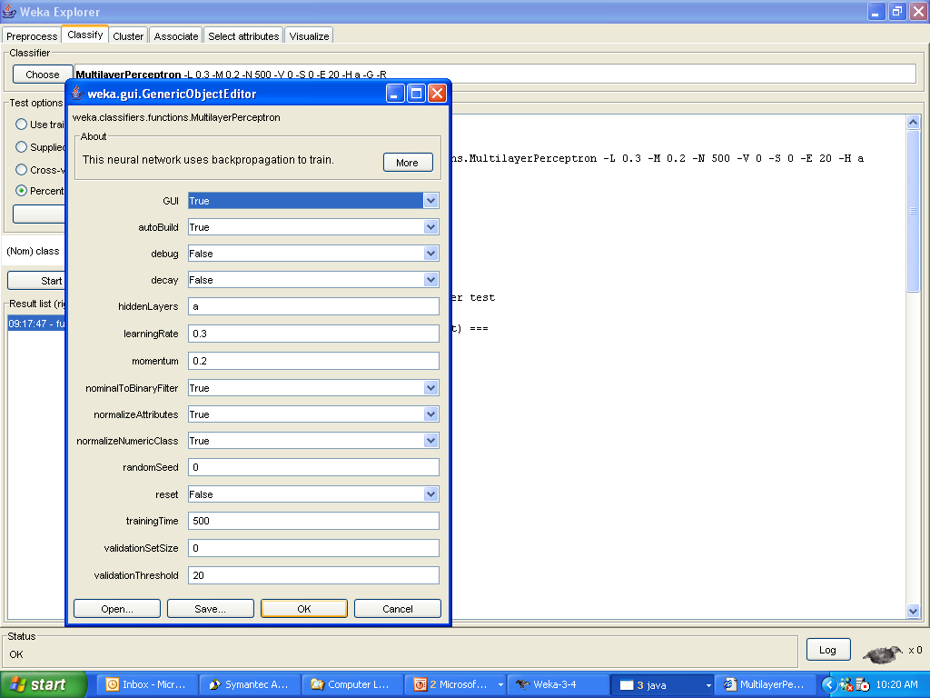

Slide 21


Slide 22
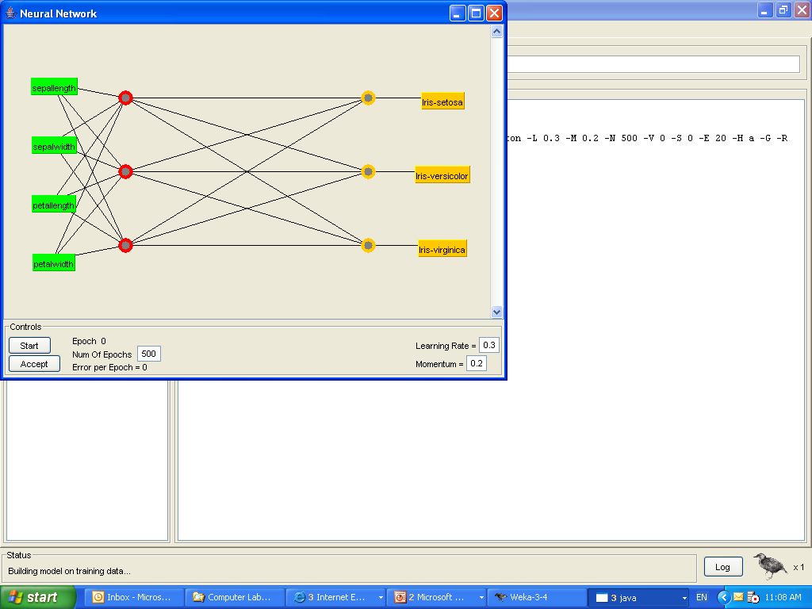

Slide 23
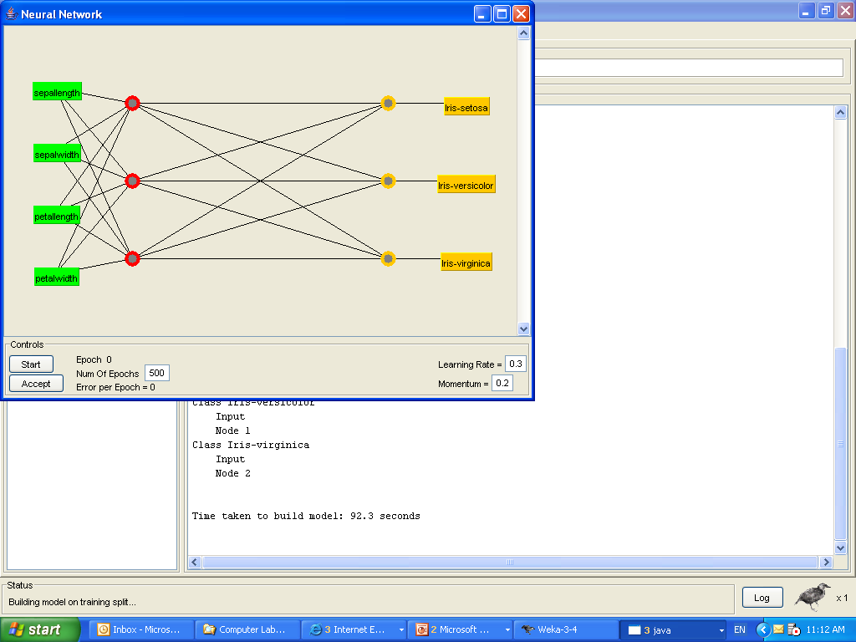

Slide 24


Slide 25
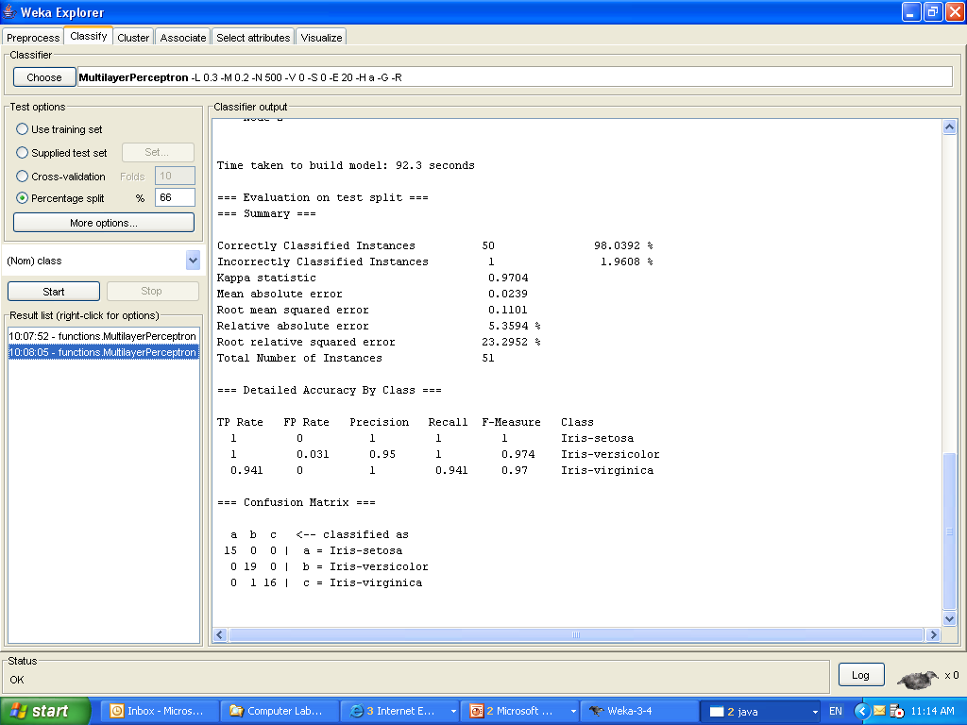

Slide 26
Other Neural Network Software
  SNNS- Stuttgart Neural Network Simulator
  http://www-ra.informatik.uni-tuebingen.de/SNNS/
  Alyuda NeuroIntelligence
    http://www.alyuda.com/neural-networks-software.htm
  “backprop.cpp” from V. Rao and H. Rao
  C++ Neural Network and Fuzzy Logic Backpropagation Simulation version 1

Slide 27
  Using “backprop.cpp”
  Download the executable file as well as the example training and testing data sets
  The training and data set were obtained from the UCI Machine Learning Repository’s Wine Recognition Database
  The original data set was randomly divided to create the training (2/3) and testing (1/3) data sets

Slide 28
  Using “backprop.cpp”
  The training data set contains the input and output values.
  The testing data set contains only the input values

Slide 29
  Using “backprop.cpp”
  Please note the changes made to the output values for this particular example.
    Class 1: output node 1 = 0; output node 2 = 0
    Class 2: output node 1 = 0; output node 2 = 1
    Class 3: output node 1 = 1; output node 2 = 1

Slide 30
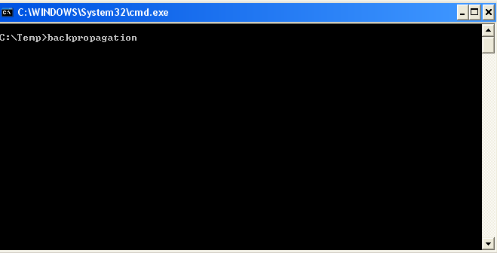
  Using “backprop.cpp” (TRAINING)
  On the DOS prompt, type “backpropagation” to run the application

Slide 31
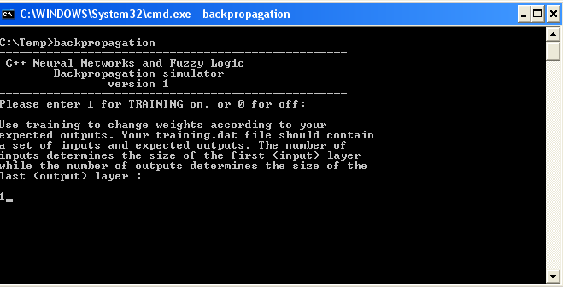
  Using “backprop.cpp” (TRAINING)
  Enter “1” for TRAINING

Slide 32
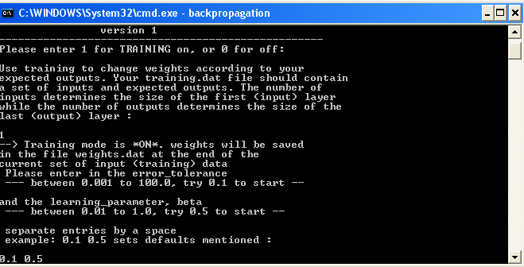
  Using “backprop.cpp” (TRAINING)
  Enter the error tolerance and the learning rate

Slide 33
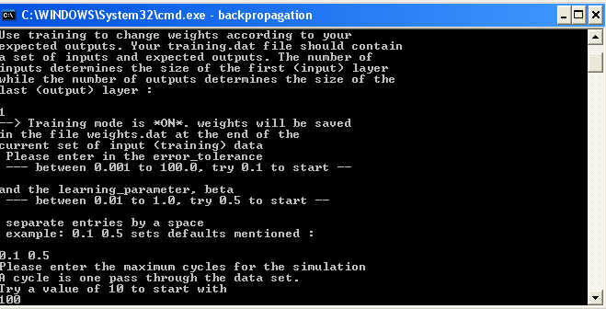
  Using “backprop.cpp” (TRAINING)
  Enter the maximum number of cycles. One cycle is one pass through the data set.

Slide 34
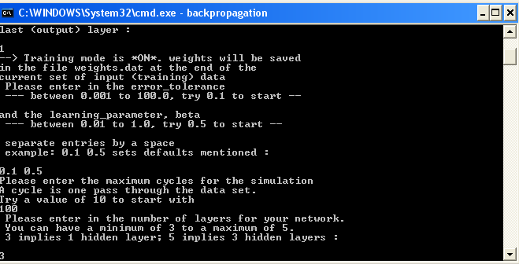
  Using “backprop.cpp” (TRAINING)
  Enter the number of layers for your network.

Slide 35
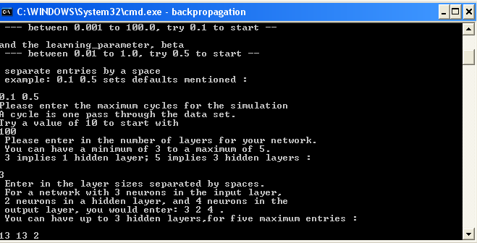
  Using “backprop.cpp” (TRAINING)
  Enter the layer sizes separated by spaces.
  IMPORTANT: the number of input and output nodes must match the training data (on the “training.dat” file)

Slide 36
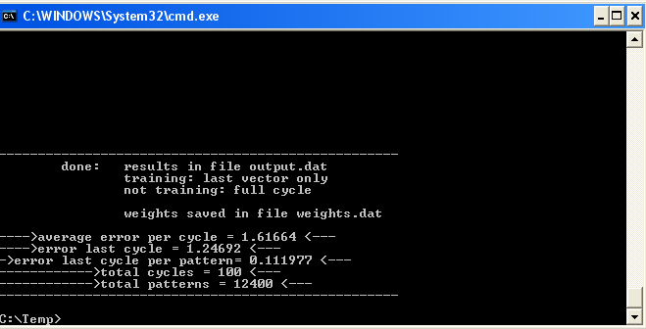
  Using “backprop.cpp” (TRAINING)
  Run the neural network. Weights were saved on the “weights.dat” file. They will be used later during testing

Slide 37
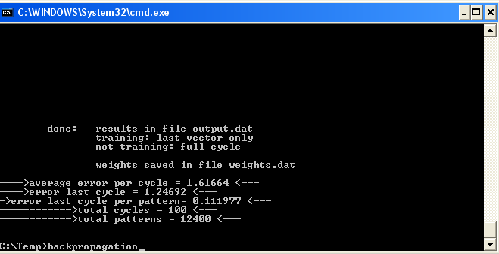
  Using “backprop.cpp” (TESTING)
  On the DOS prompt, type “backpropagation” to run the application again

Slide 38
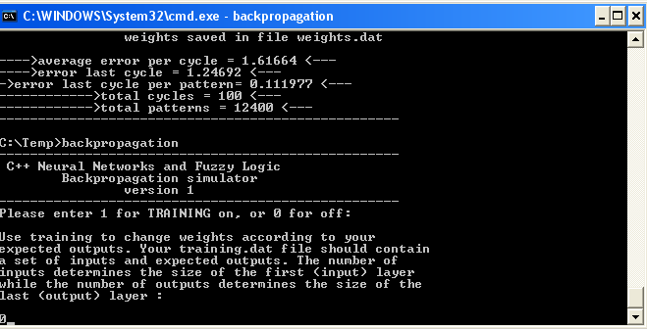
  Using “backprop.cpp” (TESTING)
  Enter “0” for TESTING

Slide 39
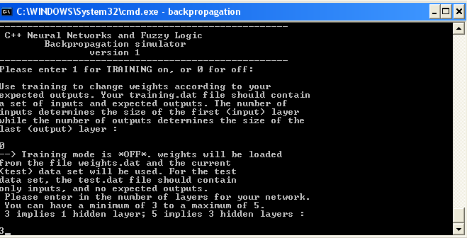
  Using “backprop.cpp” (TESTING)
  Enter the number of layers for your network. IMPORTANT: This must be the same used for training

Slide 40
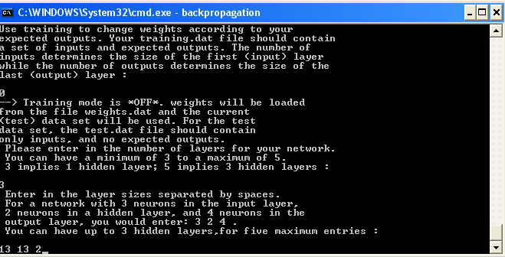
  Using “backprop.cpp” (TESTING)
  Enter the layer sizes separated by spaces.
  IMPORTANT: This must be the same used for training

Slide 41
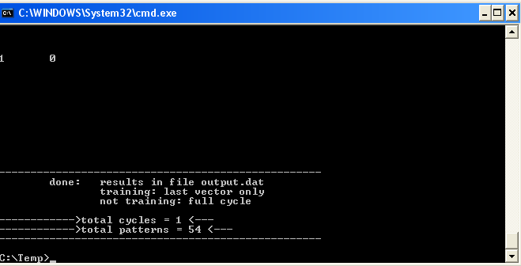
  Using “backprop.cpp” (TESTING)
  Run the neural network. Output results from the testing data set were saved on the “output.dat” file.

Slide 42
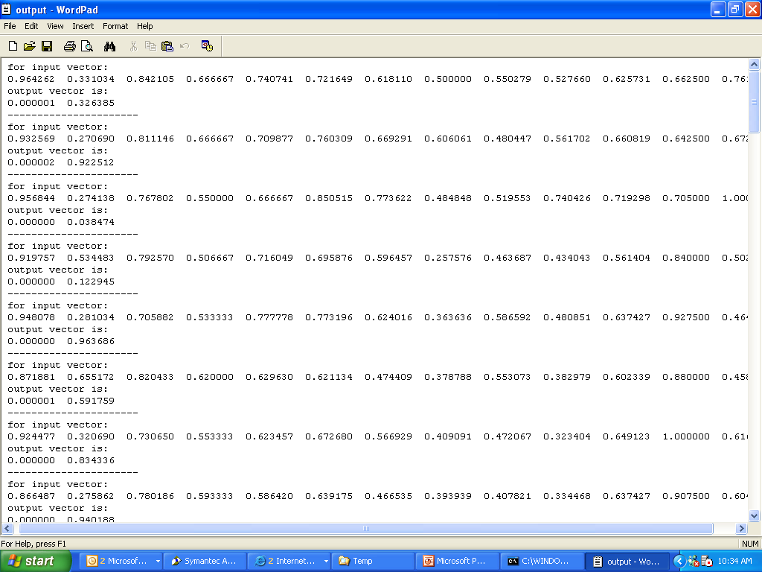
  Using “backprop.cpp” (OUTPUT)

